Slide 1

Stroop color and word test: scoring
Brian Syzdek, Psy.D. | Product Manager | Stoelting- Psychology
P 630-860-9700 E BSyzdek@StoeltingCo.com
620 Wheat Lane | Wood Dale, IL, USA 60191
Notes:
https://stoeltingco.com/stroop

Slide 2
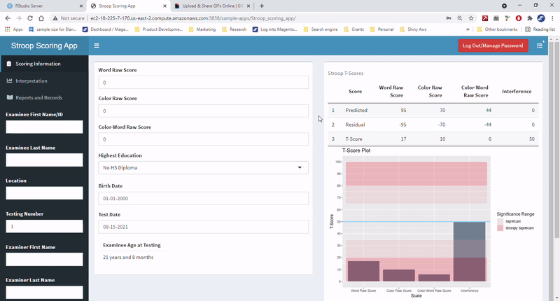
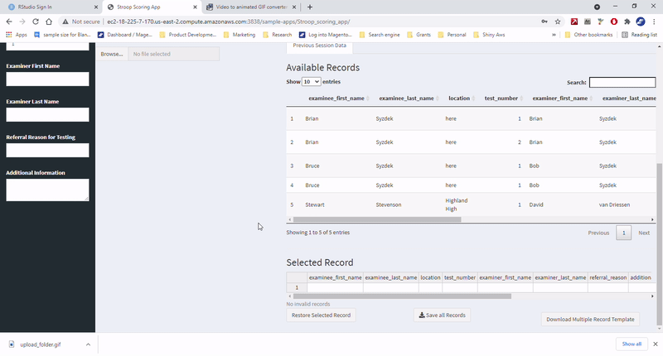

Computerized scoring
https://stoeltingco.com/stroop
Dynamic scoring and output
Reports and record management

Slide 3
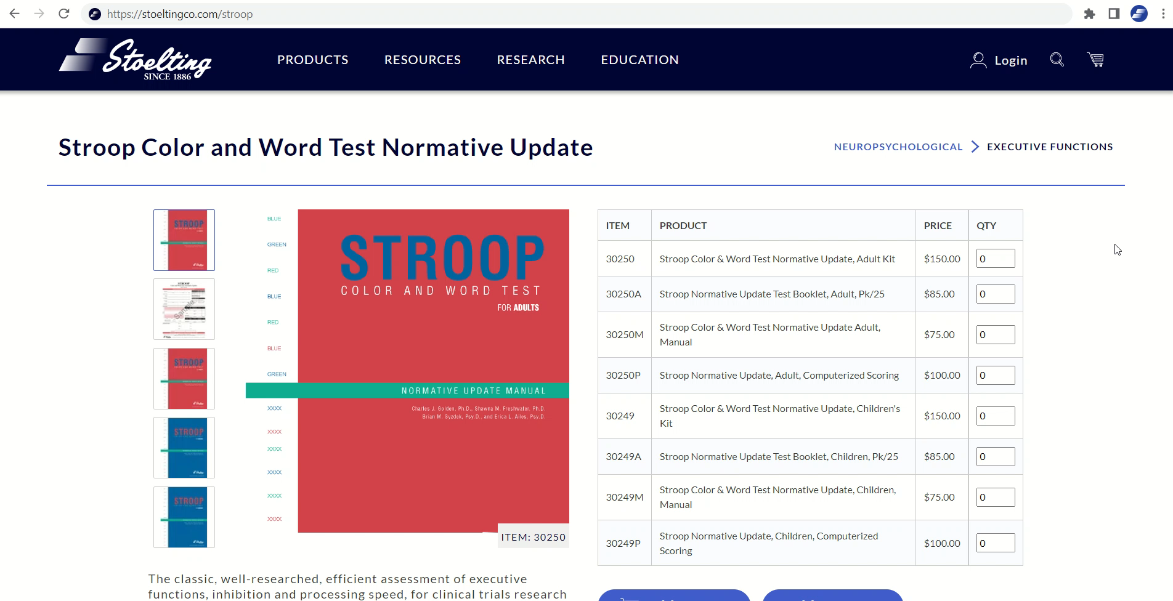
Notes:
https://stoeltingco.com/stroop

Slide 4
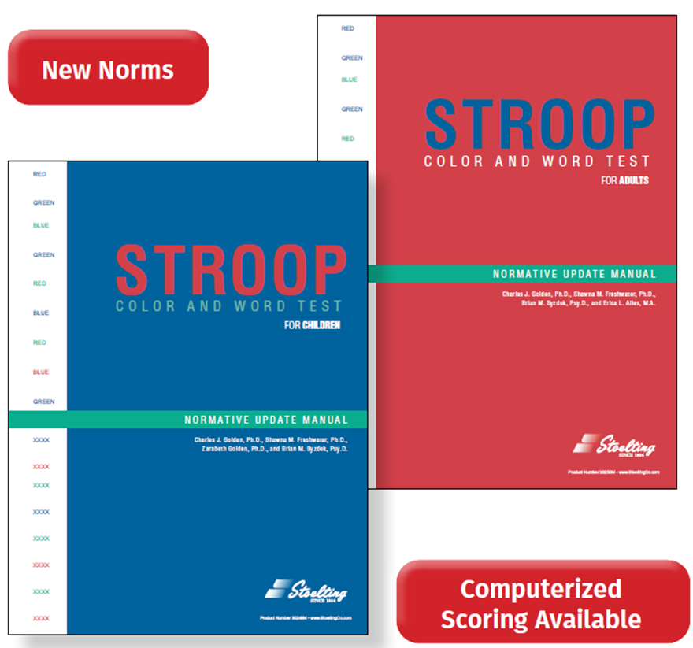
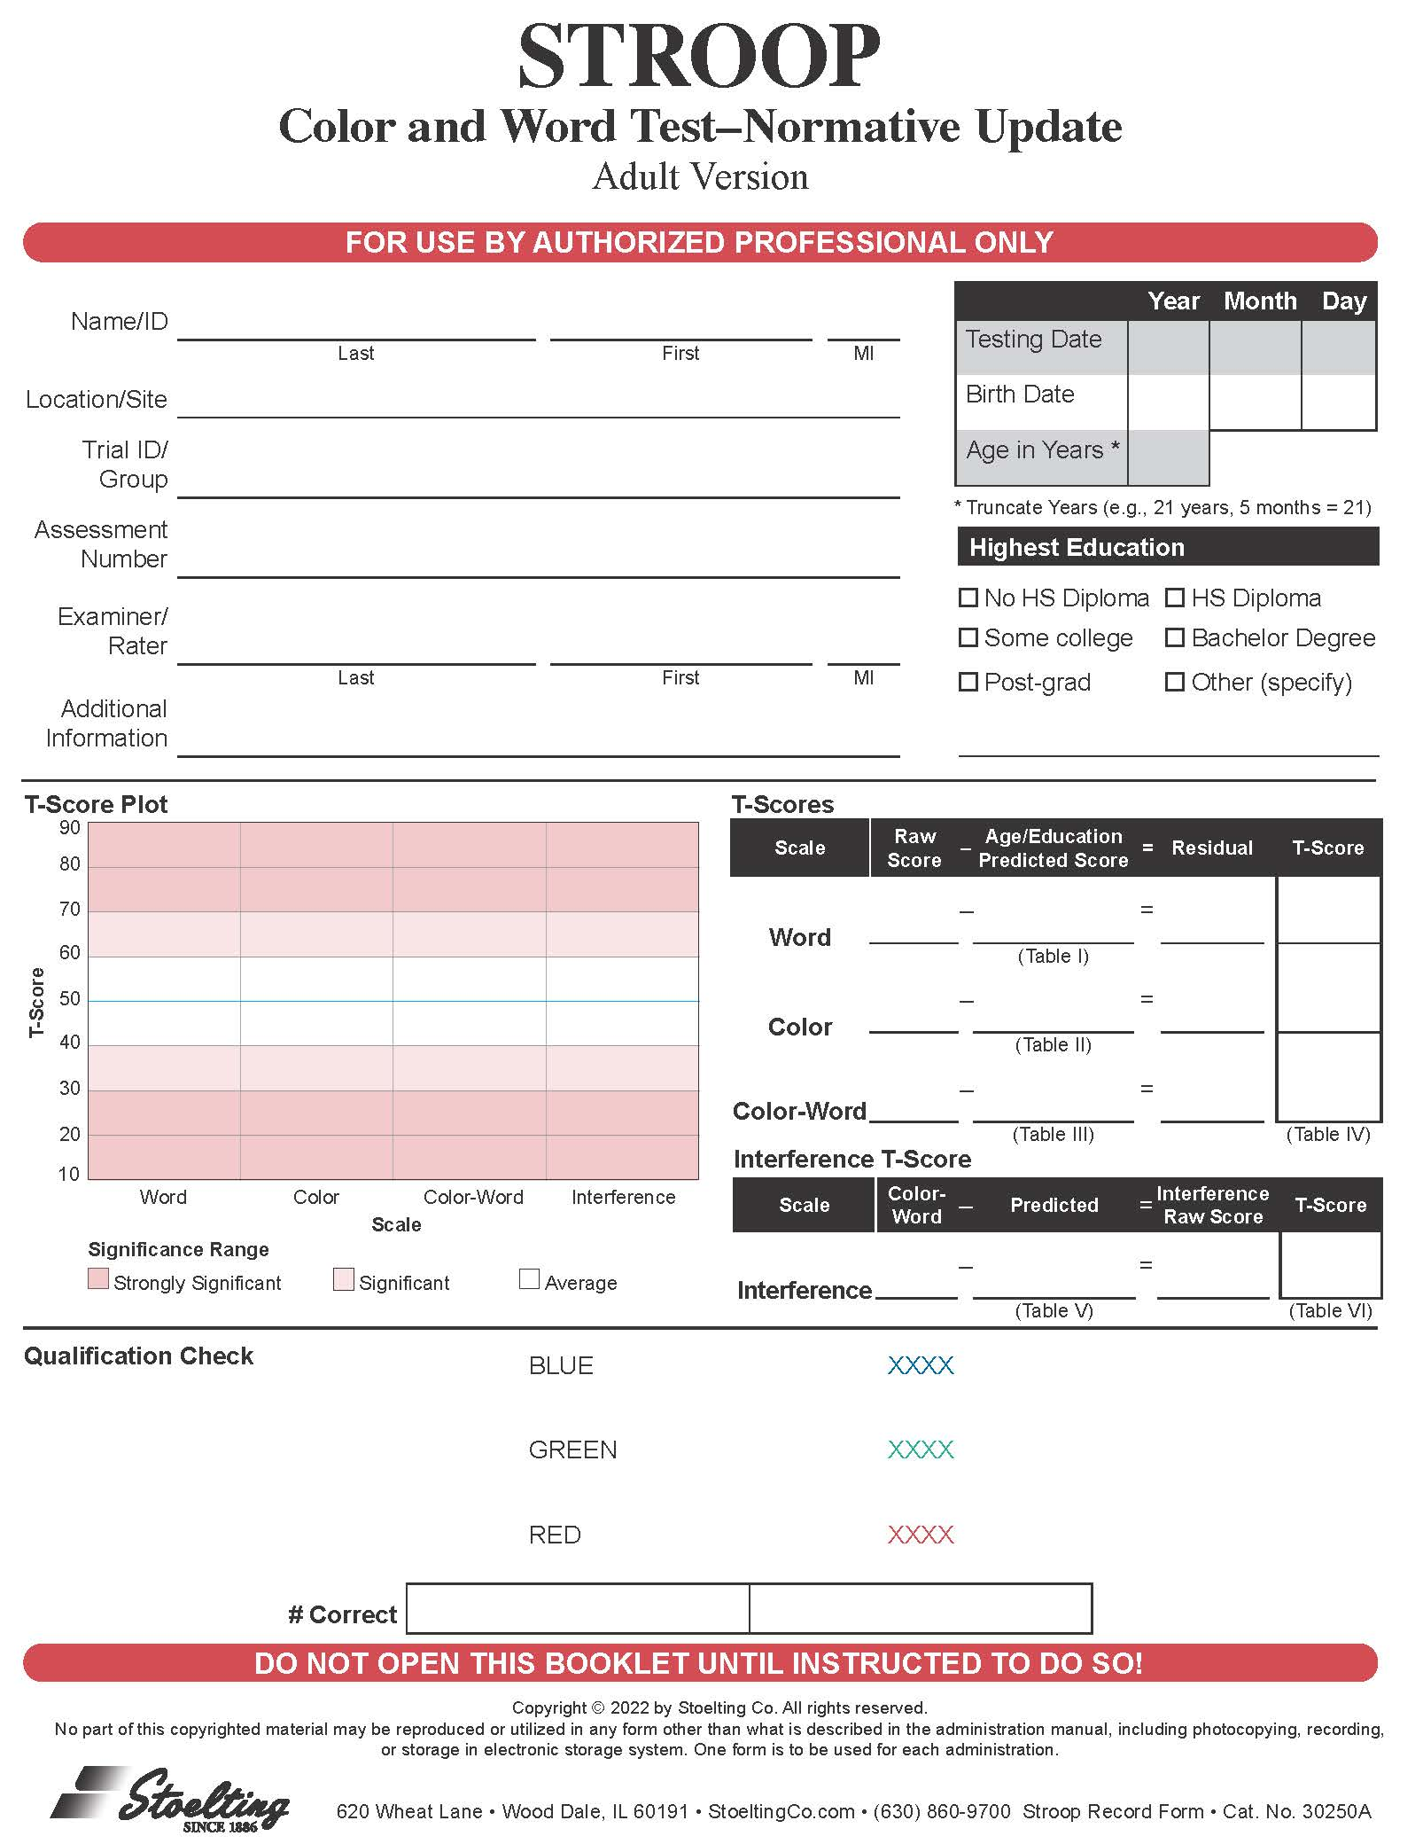
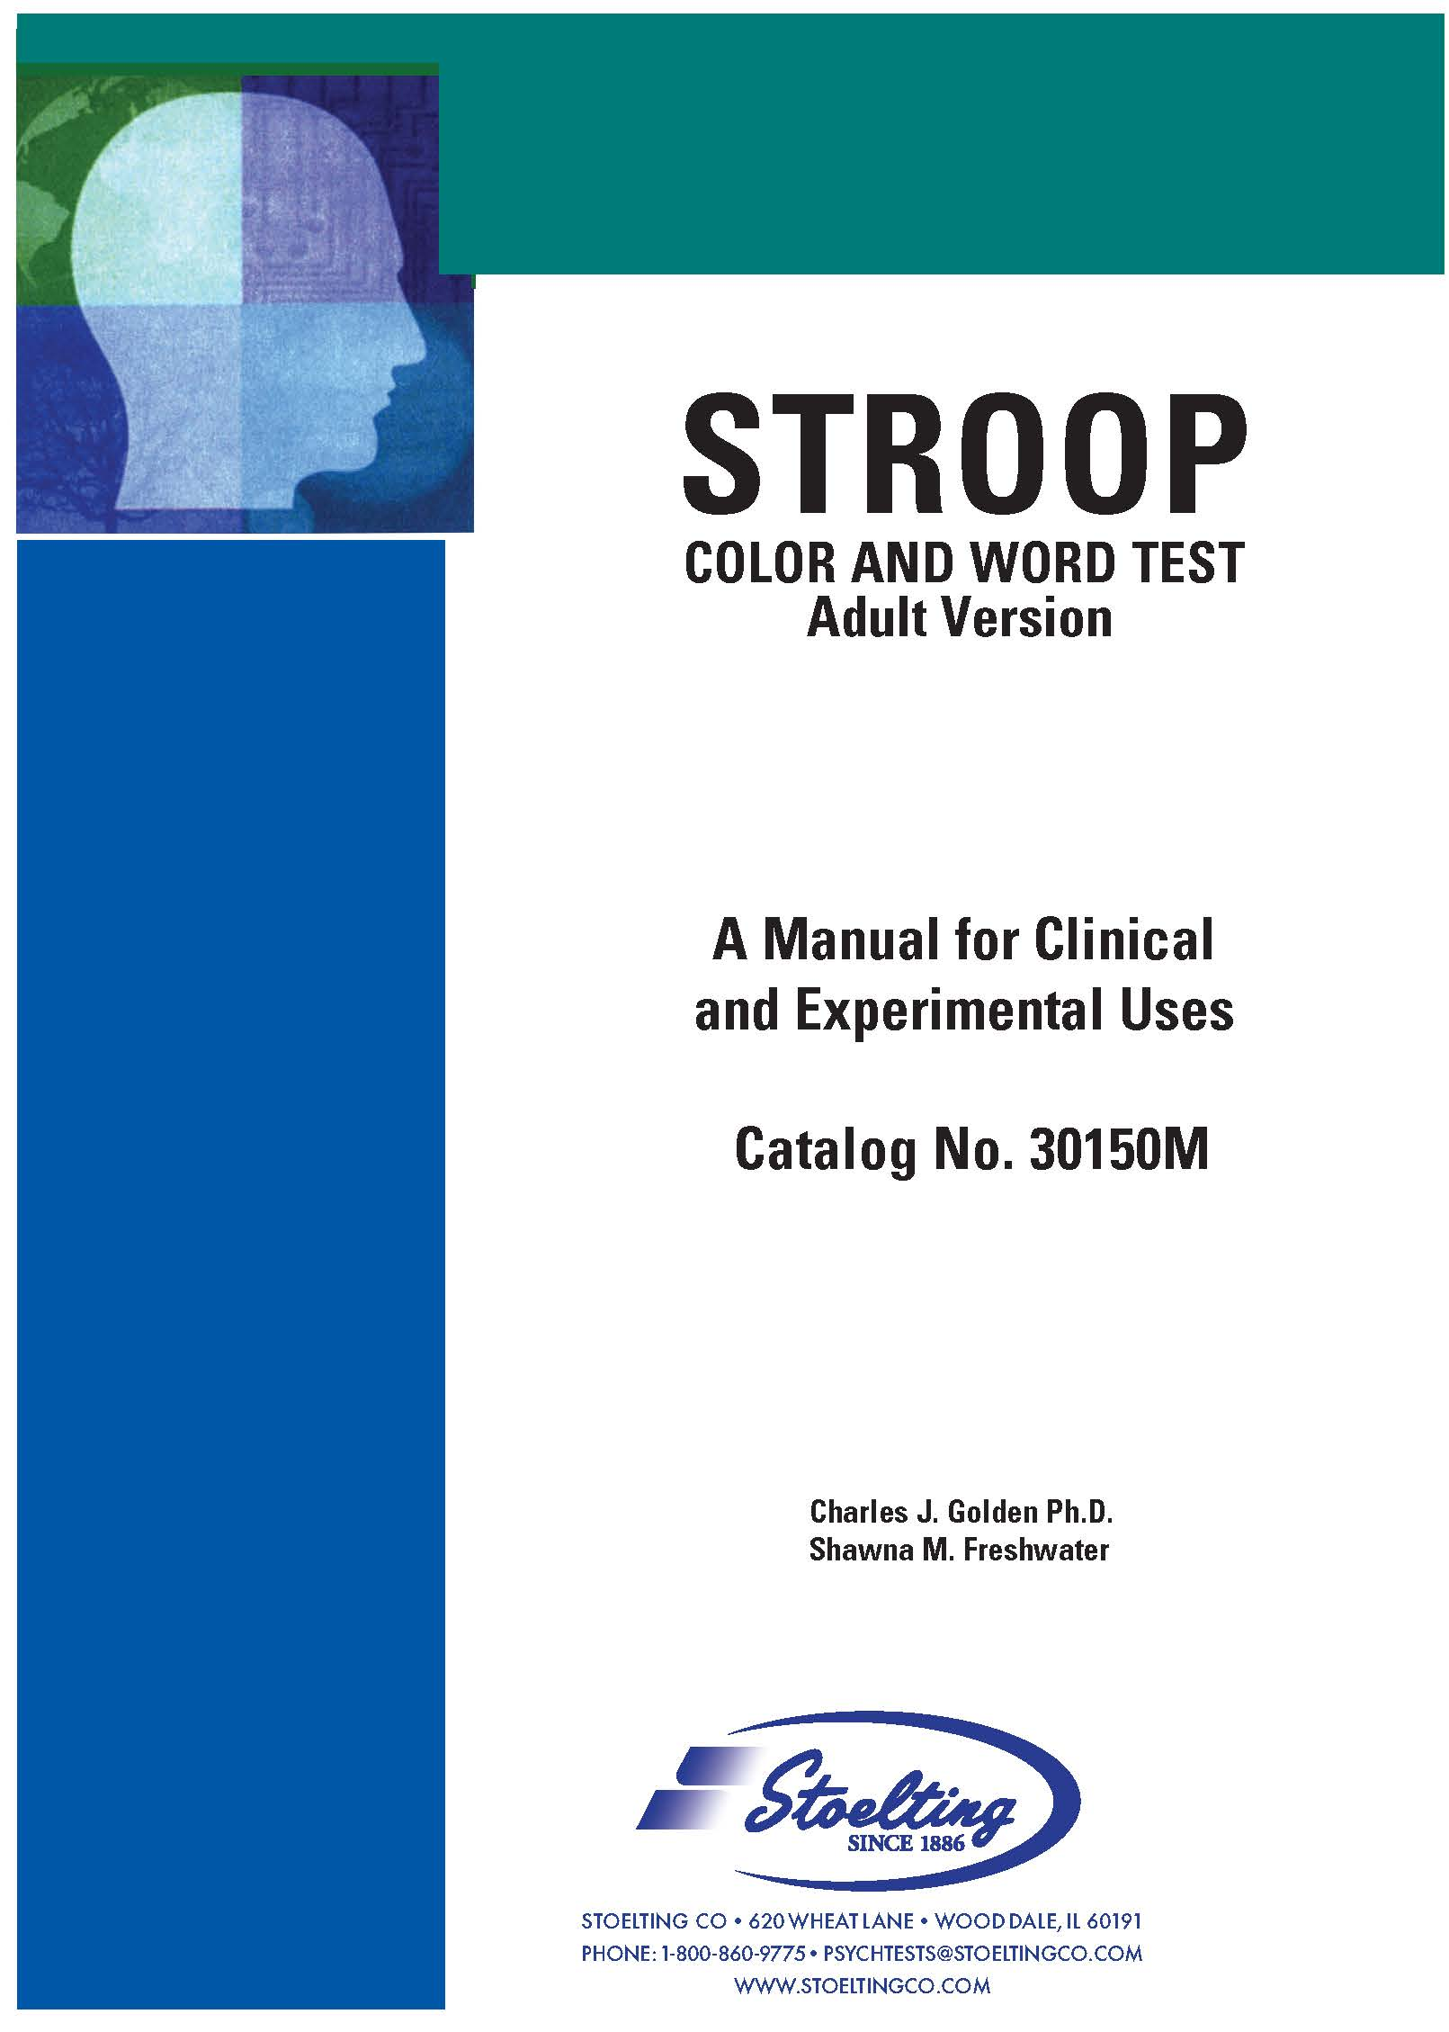
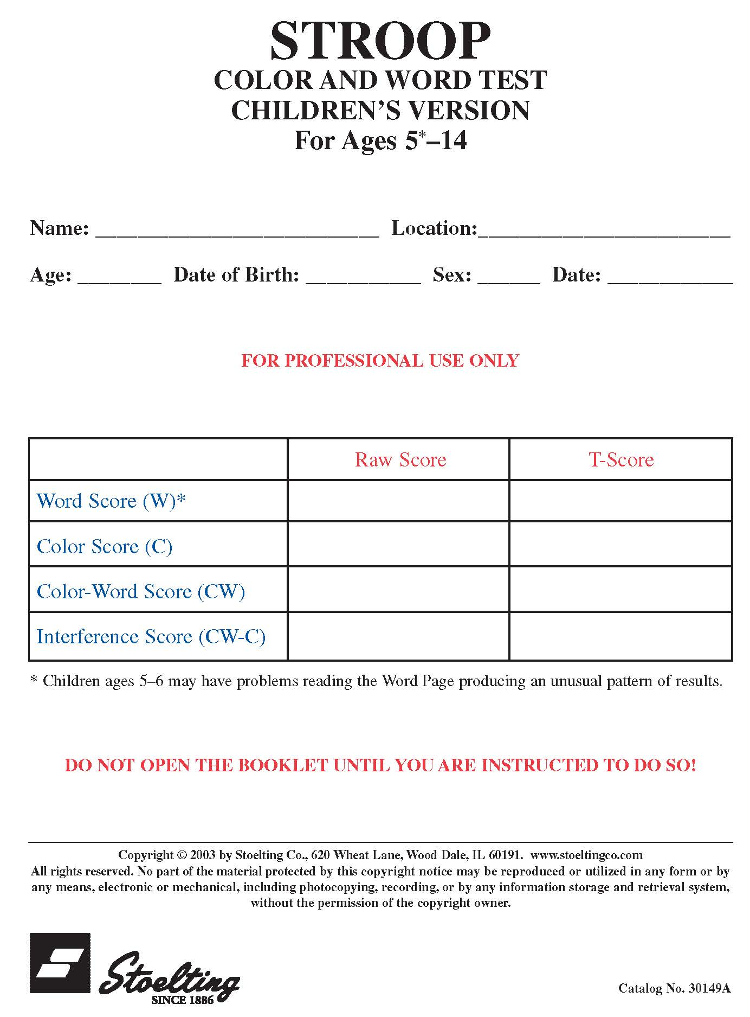
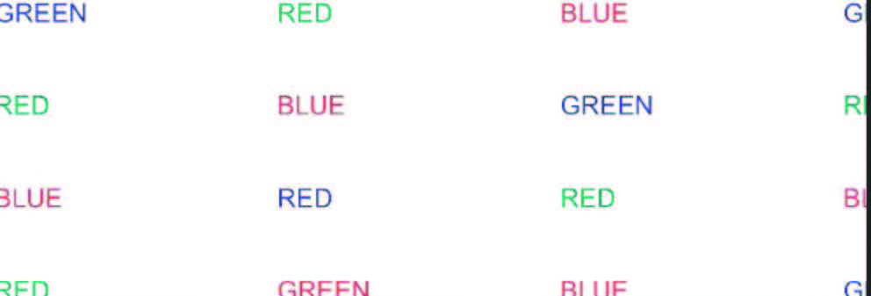
VERSIONS
NORMATIVE UPDATE- 2022
PREVIOUS- 2004
SAME INTERIOR

Slide 5
Need
ADMINISTRATION
3 raw scores- Word, Color, Color-Word
Age
Grade (adults)
MANUAL
RECORD FORM SUMMARY PAGE

Slide 6
overview
Word, Color, Color-Word
Record raw score
Obtain predicted score for each scale (age/education)
Subtract predicted from raw score = residual/deviation
Residuals -> T-scores
Interference
Predicted Interference (Word/Color)
Color-Word raw score – Predicted Interference
Interference T-Score

Slide 7
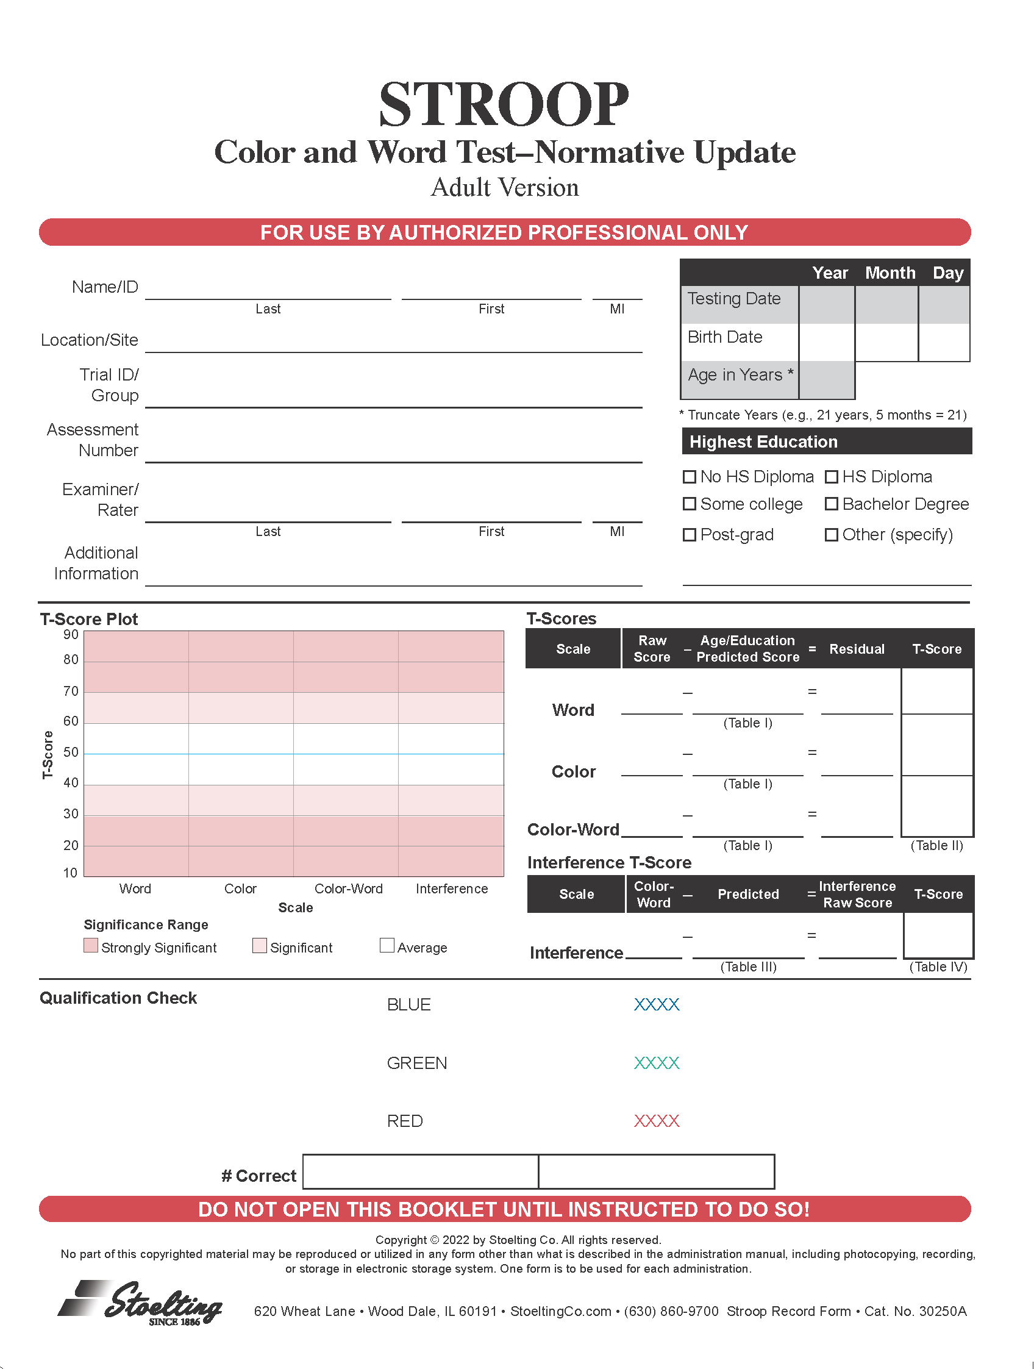
Summary page

Slide 8
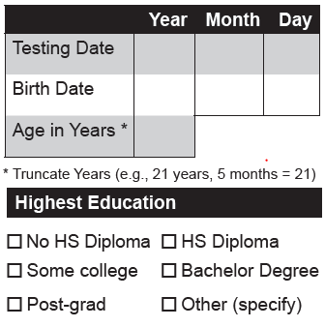
Age/education

Slide 9
Age
 | Year | Month | Day
Testing Date | 2022 | 7 | 15
Birth Date | 1951 | 10 | 30
Age in Years*
2021
6
18
45
70
8
15

Slide 10
Age/education

Slide 11

Education
Adult- Highest Completed
Children- Not needed

Slide 12
Summary page

Slide 13
Word, color, color-word
Scale | Raw Score | - | Age/Education Predicted Score | = | Residual | T-Score
Word |  | - |  | =
 |  |  | (Table I)
Color |  | - |  | =
 |  |  | (Table I)
Color-Word |  | - |  | =
 |  |  | (Table I)
 |  |  |  |  |  | (Table II)

Slide 14
1. Record raw scores
Scale | Raw Score | - | Age/Education Predicted Score | = | Residual | T-Score
Word | 50 | - |  | =
 |  |  | (Table I)
Color | 55 | - |  | =
 |  |  | (Table I)
Color-Word | 40 | - |  | =
 |  |  | (Table I)
 |  |  |  |  |  | (Table II)

Slide 15
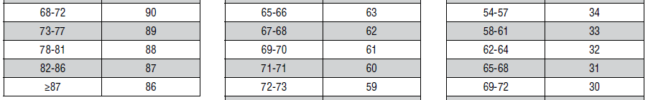
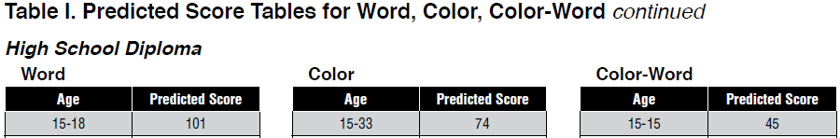
2. Predicted scores

Slide 16
2. Record Predicted scores
Scale | Raw Score | - | Age/Education Predicted Score | = | Residual | T-Score
Word | 50 | - | 90 | =
 |  |  | (Table I)
Color | 55 | - | 61 | =
 |  |  | (Table I)
Color-Word | 40 | - | 30 | =
 |  |  | (Table I)
 |  |  |  |  |  | (Table II)

Slide 17
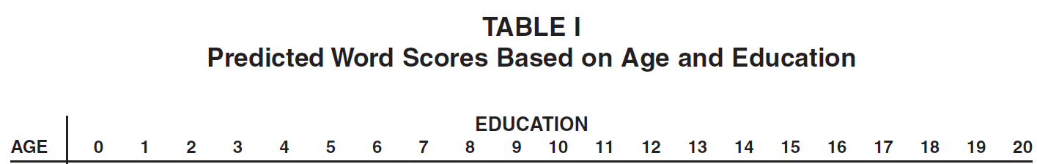
Predicted scores- previous version

Slide 18
Predicted scores- previous version
Scale | Raw Score | - | Age/Education Predicted Score | = | Residual | T-Score
Word | 50 | - | 97 | =
 |  |  | (Table I)
Color | 55 | - | 71 | =
 |  |  | (Table I)II
Color-Word | 40 | - | 32 | =
 |  |  | (Table I) III
 |  |  |  |  |  | (Table II)

Slide 19
3. Calculate residual/deviation
Scale | Raw Score | - | Age/Education Predicted Score | = | Residual | T-Score
Word | 50 | - | 90 | = | -45
 |  |  | (Table I)
Color | 55 | - | 61 | = | -5
 |  |  | (Table I)
Color-Word | 40 | - | 30 | = | 10
 |  |  | (Table I)
 |  |  |  |  |  | (Table II)

Slide 20
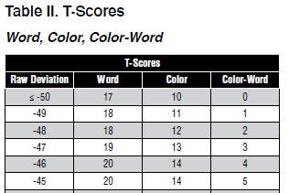
4. Residuals -> T-scores

Slide 21
4. Record T-scores
Scale | Raw Score | - | Age/Education Predicted Score | = | Residual | T-Score
Word | 50 | - | 90 | = | -45 | 20
 |  |  | (Table I)
Color | 55 | - | 61 | = | -5 | 46
 |  |  | (Table I)
Color-Word | 40 | - | 30 | = | 10 | 60
 |  |  | (Table I)
 |  |  |  |  |  | (Table II)
IV

Slide 22
Interference
Scale | Color-Word | - | Predicted | = | Interference Raw Score | T-Score
Interference | 40 | - |  | =
 |  |  | (Table III) |  |  | (Table IV)

Slide 23

5. Predicted scores

Slide 24
5. Record predicted interference
Scale | Color-Word | - | Predicted | = | Interference Raw Score | T-Score
Interference | 40 | - | 26 | =
 |  |  | (Table III) |  |  | (Table IV)

Slide 25
Predicted Interference- Previous Version
Scale | Color-Word | - | Predicted | = | Interference Raw Score | T-Score
Interference | 40 | - | 26 | =
 |  |  | (Table III) |  |  | (Table IV)
V

Slide 26
6. Color-Word raw score – Predicted Interference
Scale | Color-Word | - | Predicted | = | Interference Raw Score | T-Score
Interference | 40 | - | 26 | = | 14
 |  |  | (Table III) |  |  | (Table IV)

Slide 27

7. Residual interference -> T-score

Slide 28
7. Record Interference t-score
Scale | Color-Word | - | Predicted | = | Interference Raw Score | T-Score
Interference | 40 | - | 26 | = | 14 | 74
 |  |  | (Table III) |  |  | (Table IV)

Slide 29
Interference t-score- Previous Version
Scale | Color-Word | - | Predicted | = | Interference Raw Score | T-Score
Interference | 40 | - | 26 | = | 14 | 64
 |  |  | (Table III) |  |  | (Table IV)
V
VI

Slide 30
Completed Score table
Scale | Raw Score | - | Age/Education Predicted Score | = | Residual | T-Score
Word | 50 | - | 90 | = | -45 | 20
 |  |  | (Table I)
Color | 55 | - | 61 | = | -5 | 46
 |  |  | (Table I)
Color-Word | 40 | - | 30 | = | 10 | 60
 |  |  | (Table I)
 |  |  |  |  |  | (Table II)
Scale | Color-Word | - | Predicted | = | Interference Raw Score | T-Score
Interference | 40 | - | 26 | = | 14 | 74
 |  |  | (Table III) |  |  | (Table IV)

Slide 31
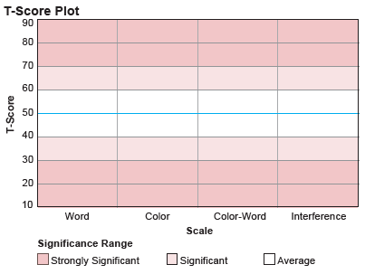
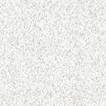
Plot t-scores

Slide 32
Summary (p.12 Manual)
 | Raw Score |  |  | Predicted
Score | Word | Color | Color-Word | Word | Color | Color-Word
Source | # Words read | # Colors read |  | Table I
Calculation | # read in 45 sec. |  |  | Consult appropriate education table and age row
Word, Color, Color-Word
Obtain age/education & raw scores during administration
Get predicted scores from manual by age/education
 | Residual |  |  | Interference
Score | Word | Color | Color-Word | Predicted | Interference
Source | Raw – Predicted |  |  | Table III | Consult appropriate education table and age row
Calculation | Word Raw – Word Predicted | Color Raw – Color Predicted | Color-Word Raw – Color-Word Predicted | Intersection of Word and Color Raw Score | Color-Word Raw – Predicted Interference
T-score source | Table II |  |  |  | Table IV
Raw scores – predicted = residuals
Convert residuals to T-scores
Interference
Get predicted Interference by Word and Color raw score
Convert Interference residual to T-score

Slide 33
Questions?
Stoelting- Psychology
P 630-860-9700 | StoeltingCo.com
620 Wheat Lane | Wood Dale, IL, USA 60191

